Slide 1
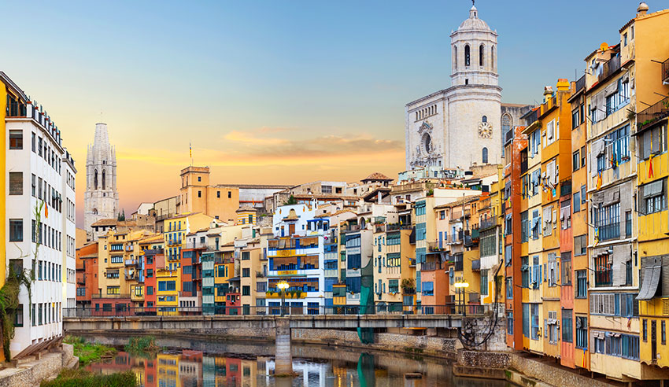
Girona - Catalonia - Spain

Slide 2
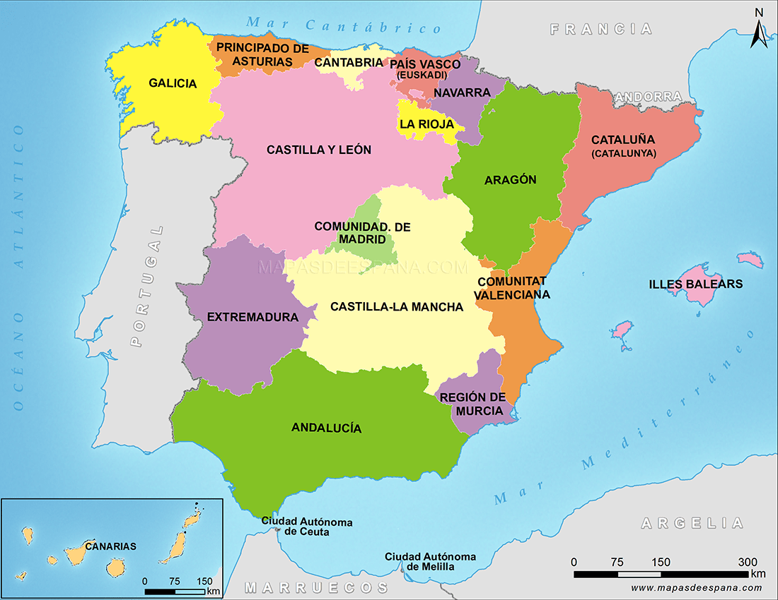

Slide 3
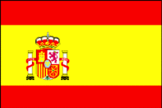
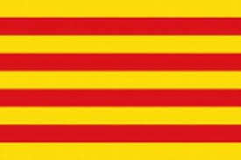
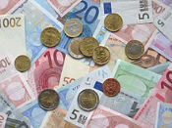
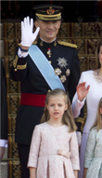
General information
Capital: Madrid
Official Languages: Spanish, Catalan (Catalonia, CCVV, Balearic Islands), Euskera (Basque Country), Galician (Galicia).
Population: 46,560,000
Surface: 505,990 sq. km
Spain
Catalonia
Currency - Euro
Spain is a parliamentary
monarchy.
Our king is Felipe VI.

Slide 4
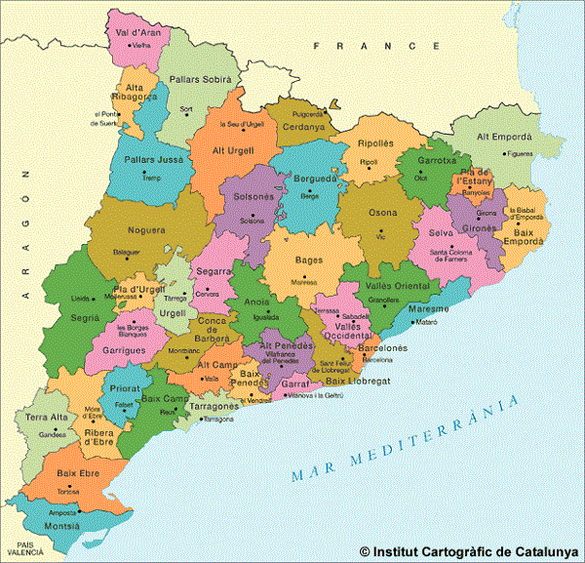
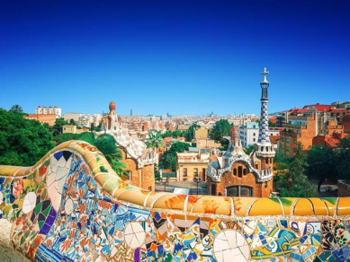
Catalonia
Catalonia is one of the regions of Spain. It is in the north-east and it borders with Andorra and France. Its capital is Barcelona.
The population is 7.5 million people.
Official languages: Spanish and Catalan

Slide 5
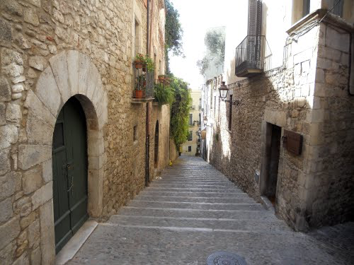
Girona
Girona is a mid-size city (97,000 hab.) in the north of Catalonia.
It is a wonderful city with a medieval quarter, lots of restaurants and a booming cultural life.
La Costa Brava, l’Empordà and the Pyrenees are part of the province.

Slide 6
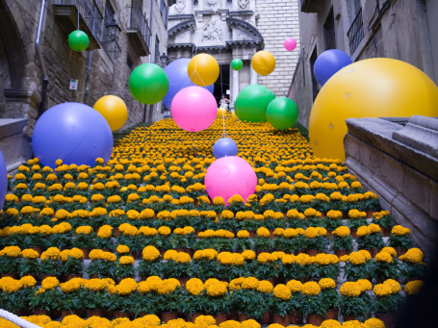
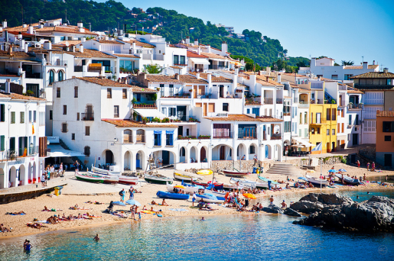
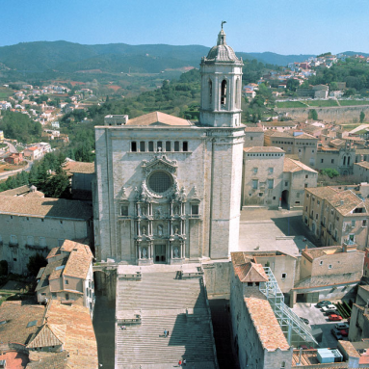
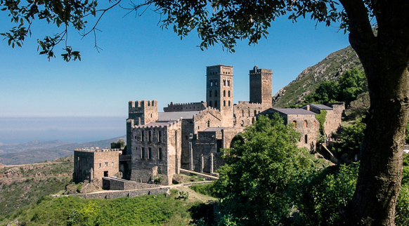

Slide 7
Summary of our history
One of the characteristic features of the history of Spain is the successive waves of different people who spread all over the Peninsula: the Iberians, the Celts, after came Greek settlers, the Phoenicians and Carthaginians. Then came the Romans who stayed for 6 centuries. After the fall of the Roman Empire, the Suevi, Vandals and Alans entered Spain, but they were defeated by the Visigoths who, by the end of the 6th century, had occupied virtually the whole of the Peninsula. At the beginning of the 8th century the Arabs entered from the south. They conquered the country swiftly except for a small bulwark in the North which would become the initial springboard for the Reconquest, which was not completed until eight centuries later. In 1469, the marriage of the Catholic Monarchs, Isabella of Castile and Ferdinand of Aragon, prepared the way for the union of the two kingdoms and marked the opening of a period of growing success for Spain. The 16th and 17th centuries witnessed the construction of the Spanish Empire as a result of which the country became the world’s foremost power.
In 1898, the Spanish Empire lost its last territories overseas. 1936-39 : Spanish Civil War
1939 - 1975: Franco’s dictatorship. 1977-78: Restoration of democracy, Constitution and elections.
1986: Spain enters the EU.

Slide 8
Evolution of the income per person
YEAR | GDP
2106 | 24,100 €
2010 | 23,200 €
2005 | 21,300 €
2000 | 15,900 €
1995 | 11,800 €
1990 | 10,331 €
1980 | 4,227 €

Slide 9
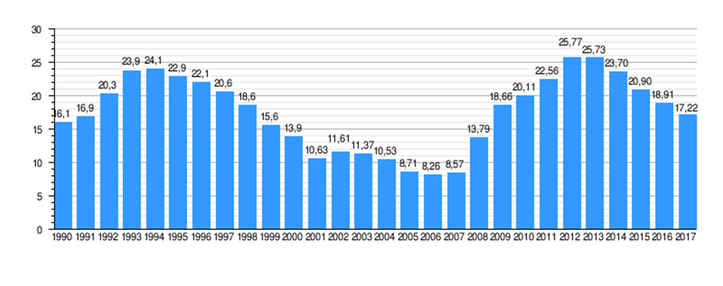
Evolution of unemployment

Slide 10
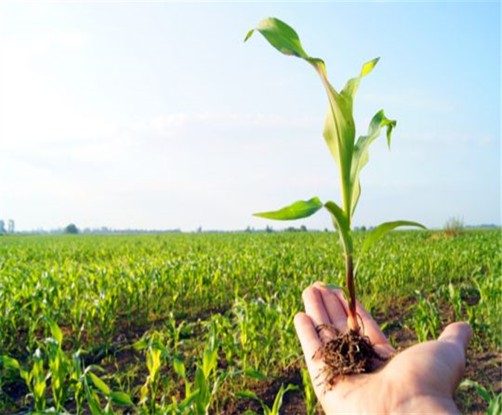
Summary of the main industries or sectors
In Spain 5% people work in
the PRIMARY SECTOR
- Agriculture
- Livestock farming
- Fishing
- Farming

Slide 11
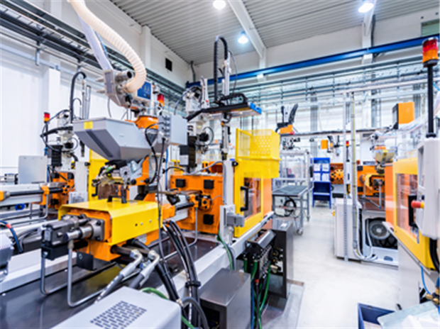
Sectors (II)
In Spain 20% people work in the
SECONDARY SECTOR
Industry
Energy
Construction

Slide 12
Sectors (III)
In Spain 75% people work in the tertiary sector. This is more than any other sector, because it makes the most money (it is very important for the Spanish economy).
- Transportation
- Commerce
- Education
- Health
- Finance
- Administration

Slide 13
Evolution of employment per sectors
 | Agriculture and fishing | Industry and energy | Construction | Services
1970 | 29% | 25% | 9% | 36%
1980 | 19% | 27% | 9% | 45%
1990 | 11% | 24% | 10% | 55%
2000 | 7% | 19% | 12% | 62%
2005 | 5% | 16% | 14% | 64%
2010 | 5% | 14% | 9% | 72%
2015 | 4% | 14% | 6% | 76%

Slide 14
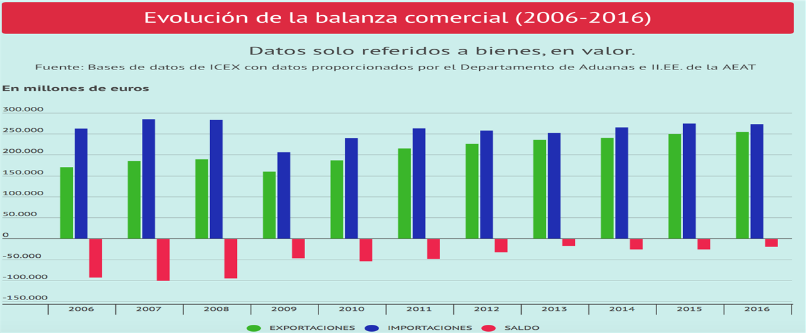
Imports and exports 2006-16

Slide 15
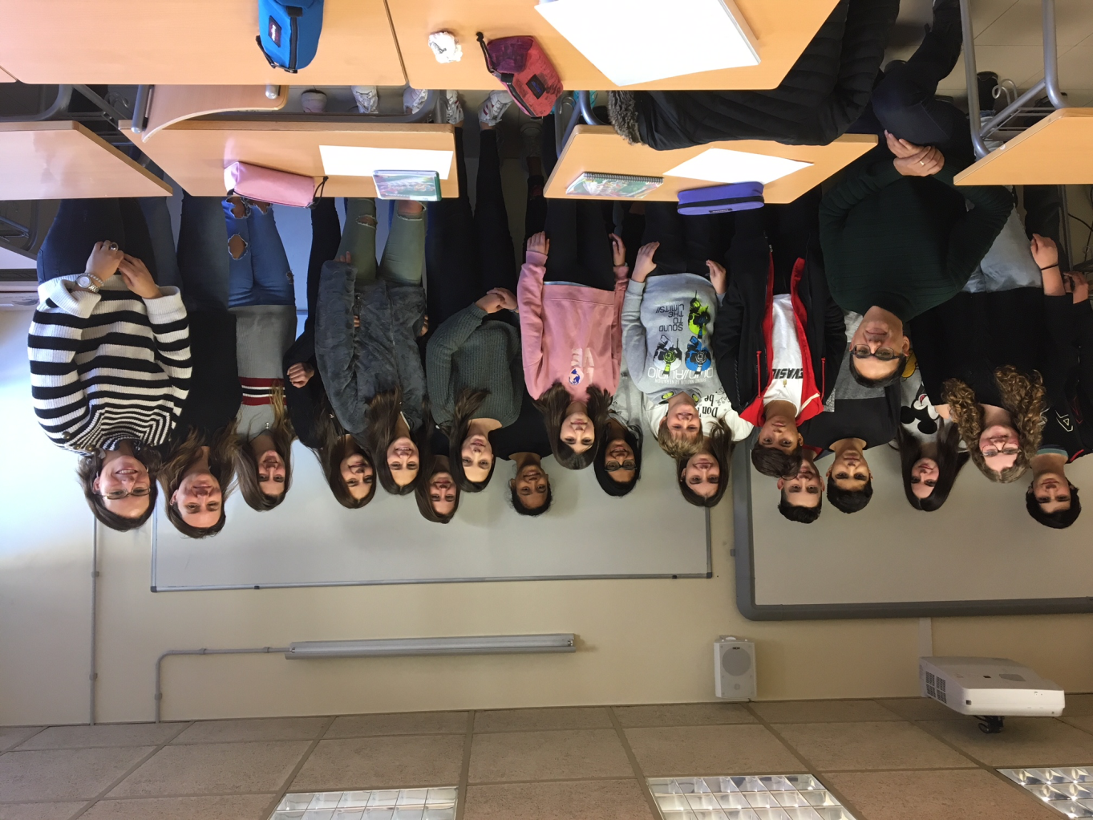
See you all in Athens!!!

